Slide 1

Exploratory Data Analysis (EDA) Of Chicago: Criminology and Sociodemographic study
Prepared by:
Charissa Leung 17078508g | Kai Yin Cheung 17016852g
Keegan Savio Carvalho 17089939g | Mengyao Wu 17083495g
Wing Tak Lo 16014484g | XiaoMing Li 17094157g
Yu Qi Xie 17089939

Slide 2




The Most Dangerous City: Chicago
Notes:
http://www.chicagotribune.com/ct-crime-in-chicago-20171114-storygallery.html
http://www.newsweek.com/chicago-homicide-shooting-crime-rate-644460
http://chicago.cbslocal.com/2017/03/15/report-illinois-poor-more-often-victims-of-violent-crime/

Slide 3

Crime in Chicago
The city's overall crime rate, especially the violent crime rate, is higher than the US average
Responsible for nearly half of 2016's increase in homicides in the US
Time, 2016

Slide 4
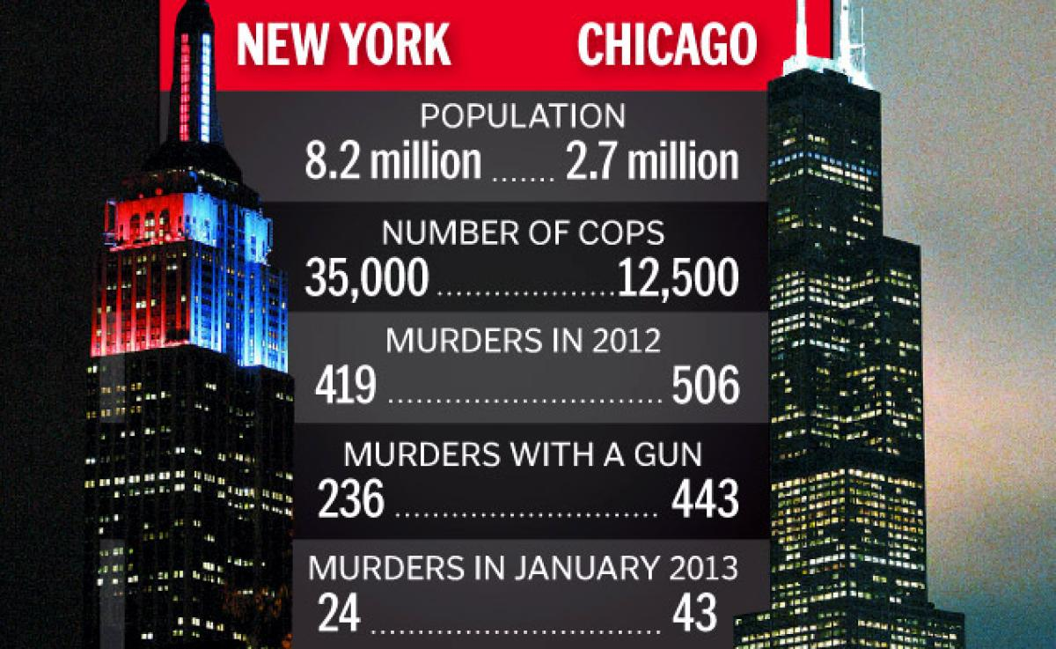
Population VS Number of Murders
Source: New York Daily News, 2013

Slide 5

What is behind the high rate of violence in Chicago?
“Poverty and violence often intersect, feed one another, and share root causes,”
About one-third of Illinois are either low-income (a family of four living on roughly $48,000) or living in poverty (family income with $48,000)
Source: CBS Chicago, 2017
Notes:
about one-third of Illinois’ 12.5 million people — roughly 3.8 million — are either low-income or living in poverty, according to the report, which defines low-income as a family of four living on roughly $48,000. About $24,000 is considered poverty level. High income is defined as a household salary of $75,000 or greater.

Slide 6


We would like to find out...
The Crime Pattern in Chicago (Statistical and Visual analysis)
2. How are poverty, lack of education, unemployment and the prevalence of crime relate to one another?
Notes:
Hypothesis: Lack of education will lead to poverty and therefore the prevalence of crime
Lack of education leads to people not having valuable job skills, which leads to low pay,and therefore to poverty for low skill workers. The poor commit crime in order to survive, or because they feel entitled to take from the “rich”

Slide 7
Data Procurement
Basemap: Geoda
Variables: American Community Survey 2014
Variables Analysed
Number of people who have a college degree (ClgGrad14)
Number of High School Graduates (HSGrad14)
Number of people without a High School Diploma (NoHS14)
Number of Violent Crimes (Violent_C)
Per Capita Income (PerClnc14)
Number of persons unemployed (Unemp14)

Slide 8
Techniques Used in Data Analysis
Descriptive and inferential statistics
Histograms, Boxplots, QQ Plots, Scatterplot Matrix
Regression analysis
Multicollinearity tests, Jarque-Bera test and Test for Heteroskedasticity. Scatter plots
Area pattern and spatial autocorrelation
Thematic Maps, Moran’s I Scatter Plots, LISA Significance and Cluster Maps

Slide 9
Crime Pattern in Chicago

Slide 10
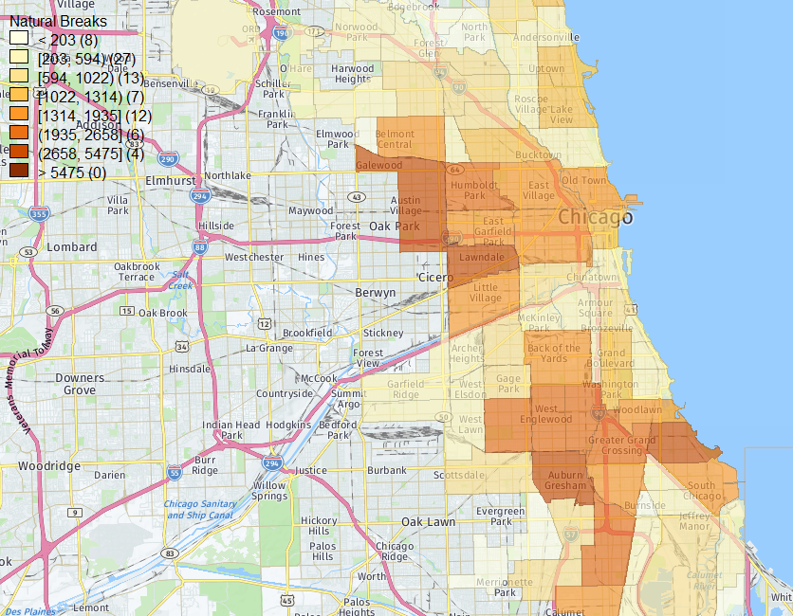
Spatial Distribution of Violent Crimes
There are two major areas for the occurrence of violent crimes which are located in the north-western and southern parts of the Chicago.
Number of crimes are relatively low along the borders
Low crime rate in central Chicago

Slide 11
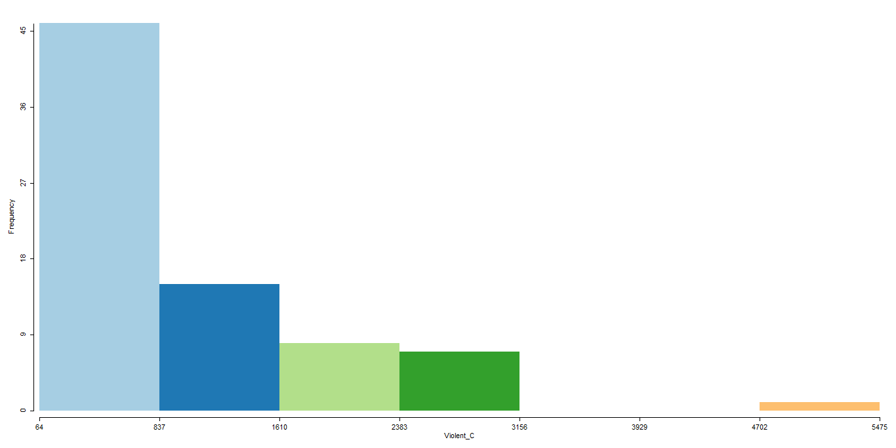
Number of Violent Crimes (Violent_C)
Histogram
A positive (right) skewed distribution

Slide 12
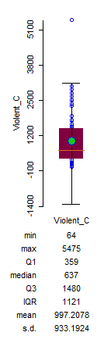
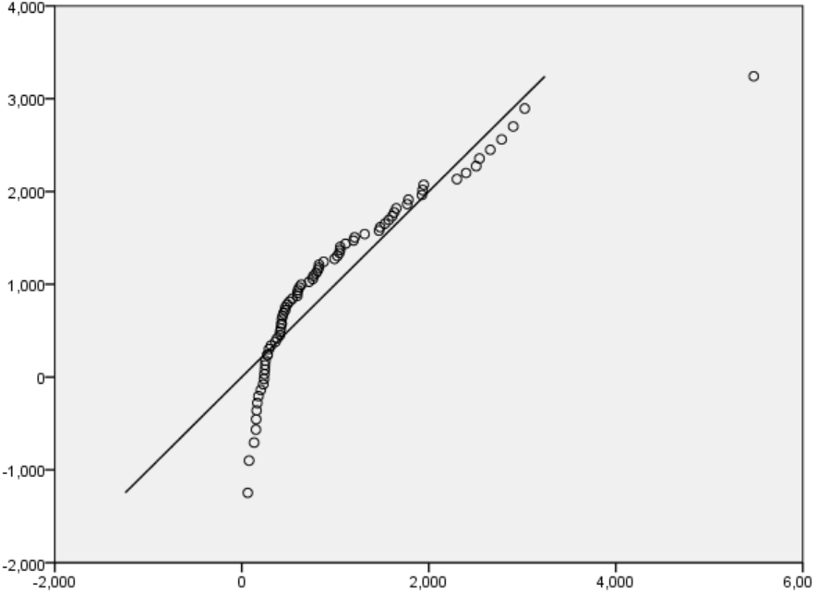
QQ Plot
Close to normal distribution
Lies on a 50 degree reference line
Box Plot
One Outlier
Median deviates from the mean
Notes:
-45 degree reference line as normal

Slide 13
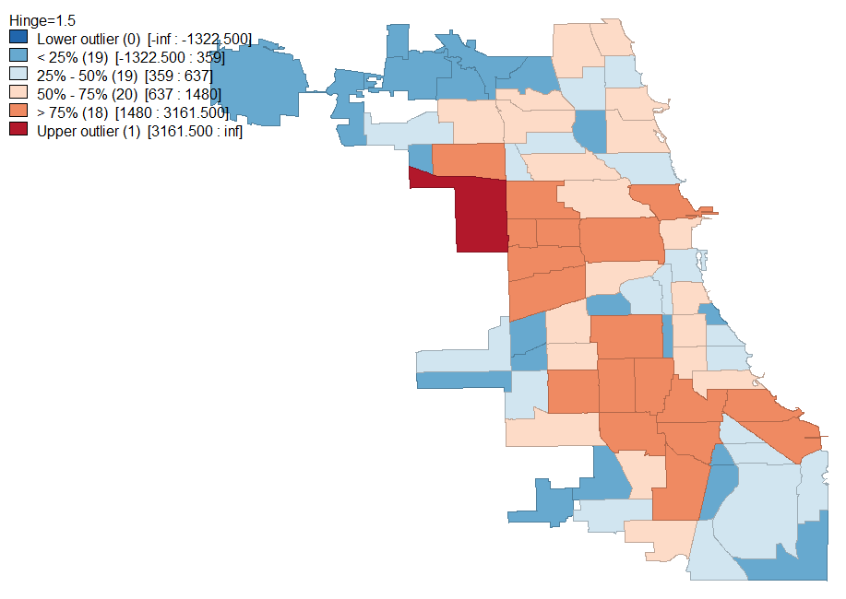
Spatial Distribution of Violent Crimes
No lower outliers detected
Upper outlier detected in the northwest of the city
Notes:
The outlier is located near Austin Village in Chicago. This place has the highest crimes commited in the whole Chicago

Slide 14
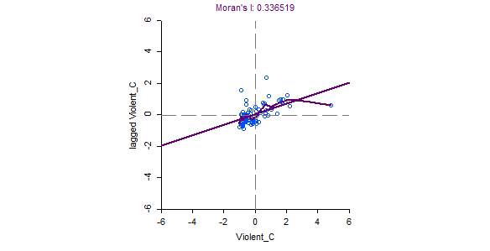
Moran’s I & Lowess Smoothing
Clustering Pattern:
Follows a positive spatial autocorrelation, meaning that the studied feature (i.e.crime occurrence) has neighboring features with similarly high or low attribute
Can’t tell about the spatial association (SA) : Hard to deduce from the scatterplot as they all cluster at the center of the graph
tes
Low/High negative SA
High/High Positive SA
Lowess Smoothing
Low/Low positive SA
High/Low negative SA
Notes:
The Lowess curve gives more accurate description of local autocorrelation values. From the plot we can see that there exists positive and negative correlations. In one region, there is no autocorrelation (See the part near the cross-points. The pink line is flat.)
http://www.statisticshowto.com/lowess-smoothing/

Slide 15
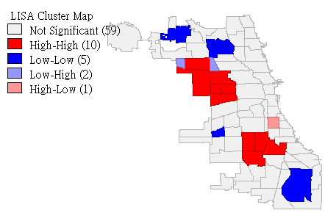
Local Indicator of Spatial Association (LISA)
Red highlighted region: areas that have high values of variables and have neighbors with high values as well (i.e. high-high)
Contribute significantly to a positive spatial autocorrelation outcome
Blue highlighted region: areas with low values of the variable and have neighbors with low values
Contribute significantly to a negative spatial autocorrelation outcome
White Region: not statistically significant and do not contribute significantly to the global trend
Notes:
If is often found that in the context of area pattern analysis that derive a global, whole map measure is often not the thing that analysts are interested. Instead, it may be more important to know which local features in the data are contributing most strongly to the over pattern. In the context of spatial autocorrelation, the localized phenomena of interest are those areas on the map that contribute strongly to the overall trend.

Slide 16
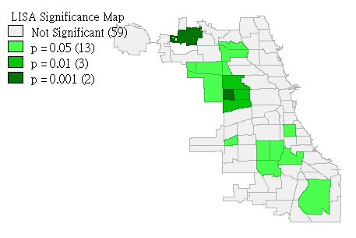
LISA Significance Map
(LEFT) This displays the statistical significance level at which each region can be regarded as making a meaningful contribution to the global autocorrelation outcome

Slide 17
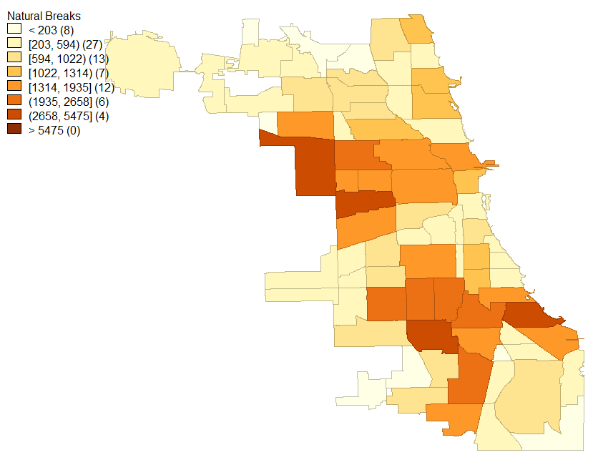
Local Indicator of Spatial Association (LISA)
Notes:
https://www.e-education.psu.edu/geog586/l9_p11.html

Slide 18
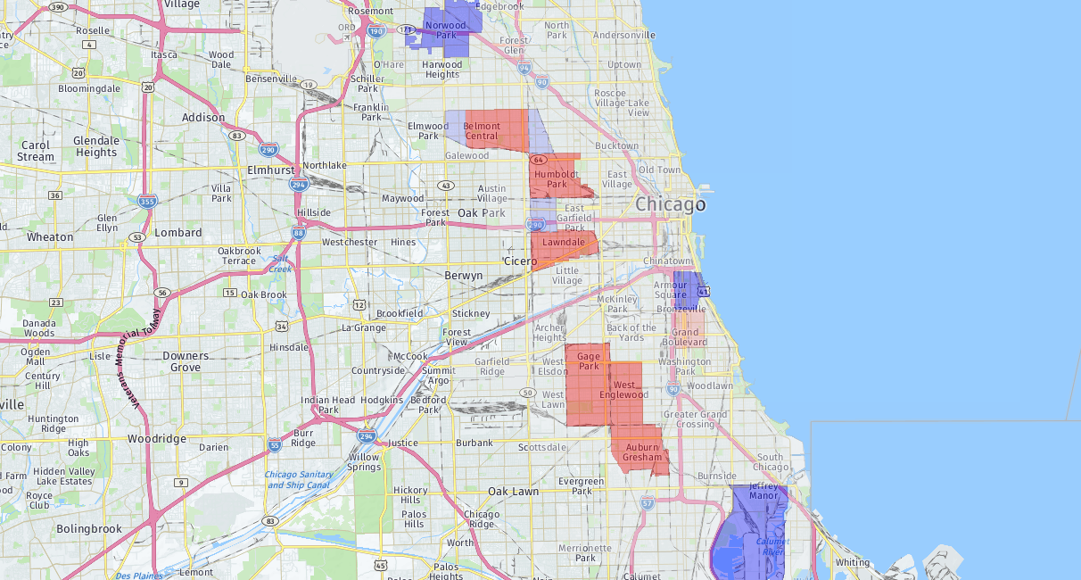

Slide 19
Sociodemographic Factors

Slide 20
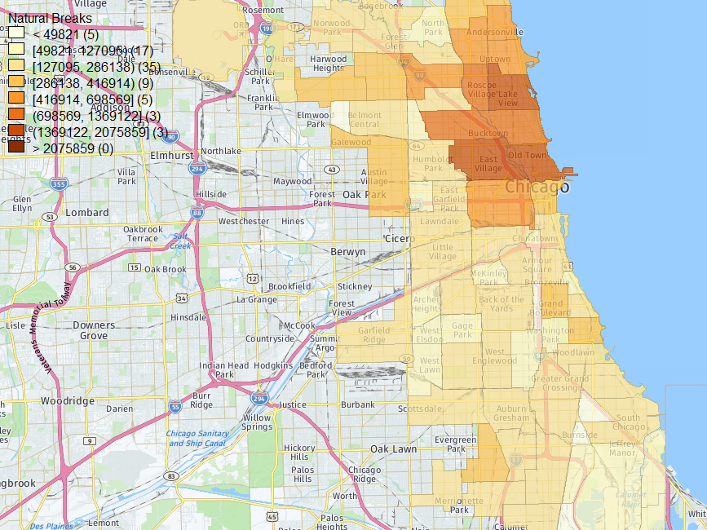
Spatial Pattern of Income Distribution per Capita
The wealthy ones are concentrated in the central and northern parts of Chicago
The low income earners cover major parts of Southern Chicago.

Slide 21
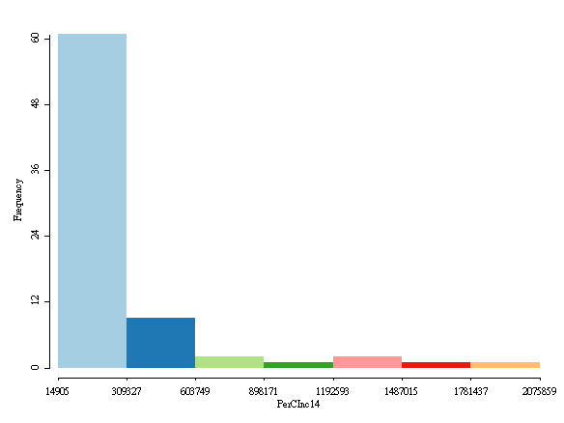
Per Capita Income (PerCln14)
Histogram
A positive (right) skewed distribution

Slide 22
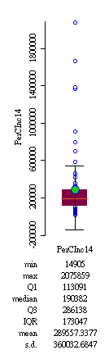
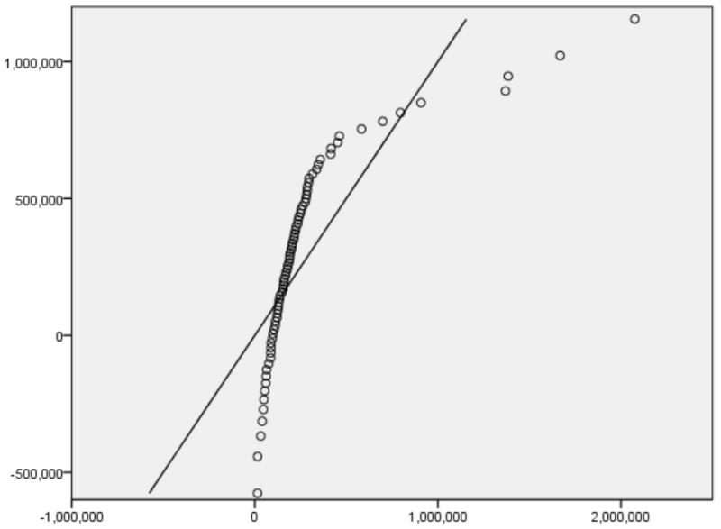
QQ Plot
Less likely to follow a normal distribution
Lies on a 65 degree reference line
Box Plot
8 Outliers
Median deviates from the mean

Slide 23
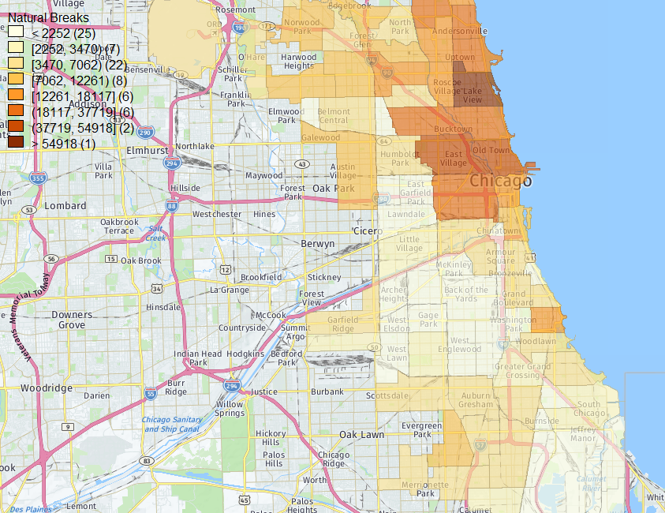
Spatial Pattern of the Population who have a college Degree
The majority of the educated population is located in the central and northern parts
The proportion of educated population declines as it moves towards the fringe of the city
The educated population is the least concentrated in the south and the west

Slide 24
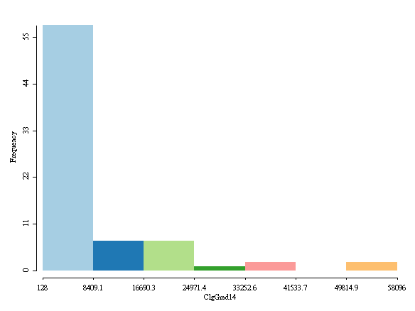
Number of people who have a college degree (ClgGrad14)
Histogram
A positively skewed distribution
Notes:
Very few places in Chicago have many college graduates.

Slide 25
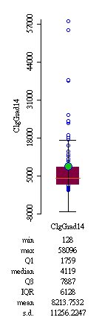
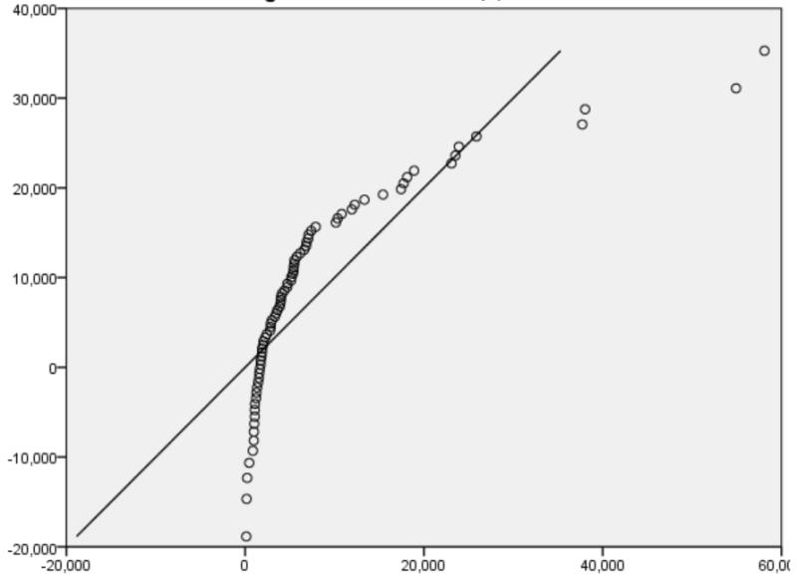
QQ Plot
Close to normal distribution
Lies on a 50 degree reference line
Box Plot
12 outliers
Great deviation of median from the mean

Slide 26
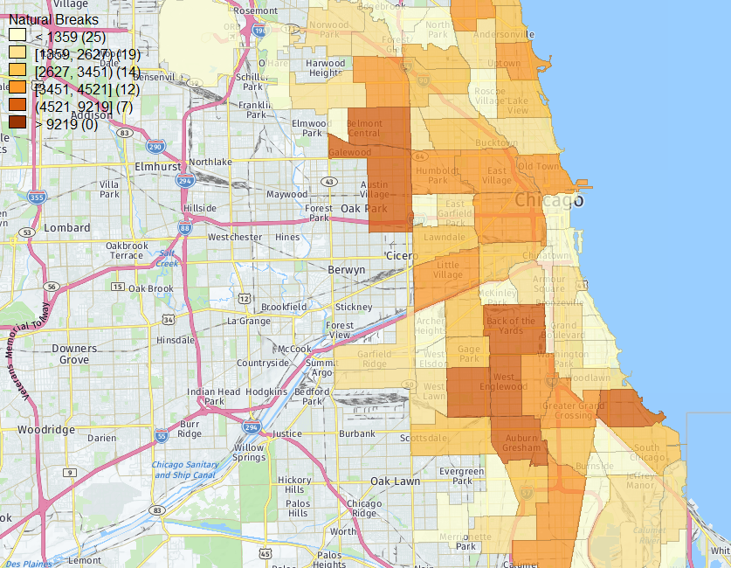
Spatial Pattern of the Population who are unemployed
From the map, we can see that majority of the unemployed population is concentrated on the western and southern parts of Chicago

Slide 27
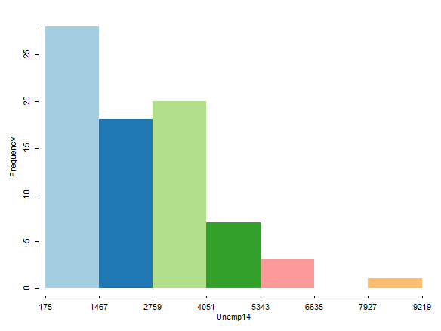
The Population who are unemployed
Histogram
A right skewed distribution

Slide 28
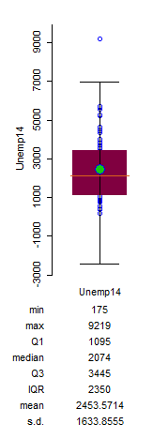
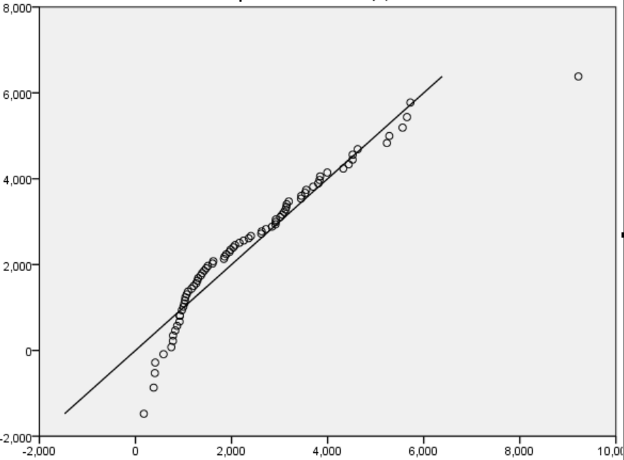
QQ Plot
Close to normal distribution
Lies on a 50 degree reference line
Box Plot
1 outlier
Slight deviation of median from the mean

Slide 29
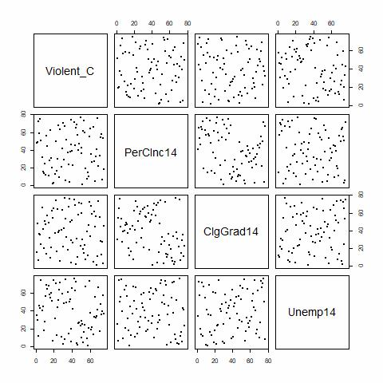
Scatter plot Matrix
Number of Crimes
Variables spread out randomly in all scatterplots
Relationships can hardly be deduced from the matrix
Per Capita Income
Number of people with college degree
Unemployed population

Slide 30
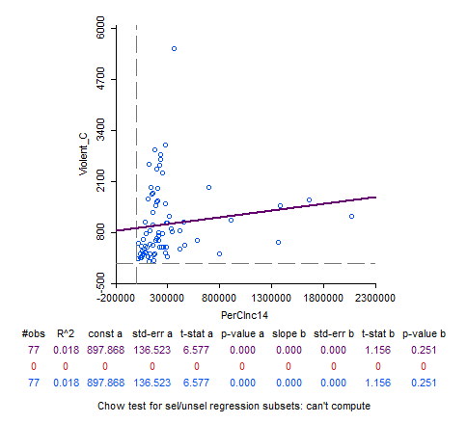
Scatterplot Analysis: Violent crimes VS Per Capita Income
Purple fitted line:
weak positive correlation
R square= 0.018
How close the data is relative to the fitted regression line
There is a negligible relationship between the per capita income and the number of violent crimes committed.

Slide 31
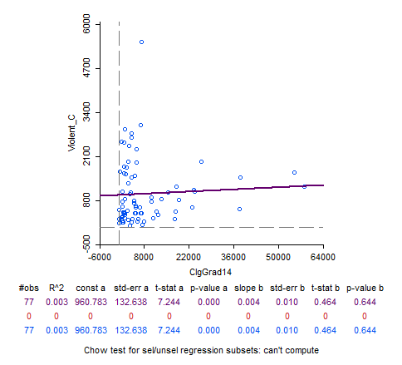
Scatterplot Analysis: Number of College Graduates VS Violent crimes
Purple fitted line:
Weak positive correlation
R square= 0.003
There is no relationship between the number of college graduates and violent crimes committed.

Slide 32
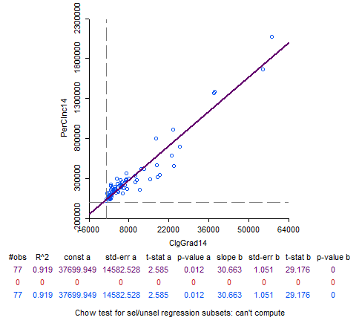
Scatterplot Analysis: Per Capita Income VS Number of College Graduates
Purple fitted line:
Positive correlation between 2 variables
R square:
R^2 = 0.919: Strong positive relationship exists between Per Capita Income and the number of College graduates
Notes:
http://blog.minitab.com/blog/adventures-in-statistics-2/regression-analysis-how-do-i-interpret-r-squared-and-assess-the-goodness-of-fit
http://blog.minitab.com/blog/adventures-in-statistics-2/how-to-interpret-regression-analysis-results-p-values-and-coefficients
http://support.minitab.com/en-us/minitab-express/1/help-and-how-to/graphs/scatterplot/interpret-the-results/key-results/

Slide 33
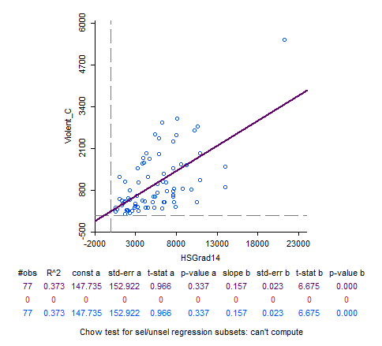
Scatterplot Analysis: Number of Violent Crime VS Number of High School Graduates
Purple fitted line:
Positive correlation
R square: 0. 373
There is a weak positive relationship between the number of adults with a high school diploma and the number of violent crime.

Slide 34
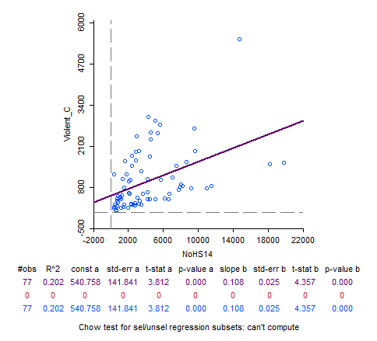
Scatterplot Analysis: Violent crimes VS Number of Adults without a High School Diploma
Purple fitted line:
Weak positive relationship
R square:0. 202
There is a weak positive relationship between the number of adults without a high school diploma and violent crimes committed.

Slide 35
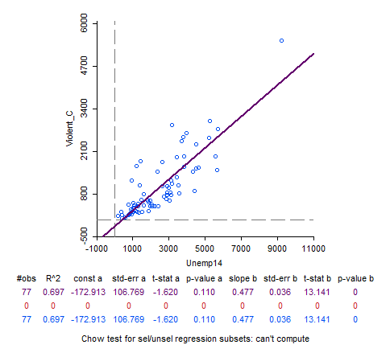
Scatterplot Analysis: Violent crimes VS Unemployed Population
Purple fitted line:
Strong positive relationship
R square: 0. 697
There is a moderate/strong positive relationship between unemployed population and violent crimes committed.

Slide 36
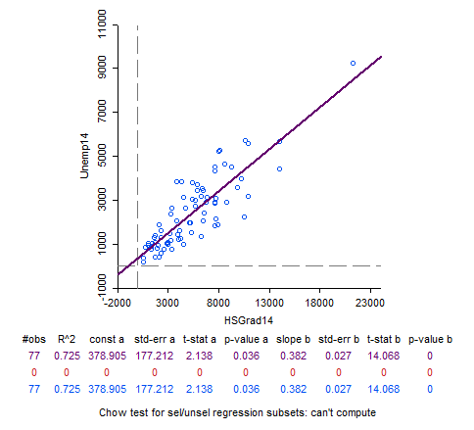
Scatterplot Analysis: Unemployment VS Number of High School Graduates
Purple fitted line:
Positive Correlation
R square: 0. 725
There is a moderate/strong positive relationship between the number of adults with a high school diploma and the number of unemployed.

Slide 37
A little insight on Regression Analysis
Multicollinearity
values above 30 need to be looked at with caution (indicates high correlation between variables).
Adjusted R-squared
Indicates variation between dependent and independent variables. Values range from 0 to 1.
Coefficient
Sign indicates positive or negative relation.
Measures of comparability
A lower AICc value indicates model is a better fit for data
Notes:
The Jarque-Bera Test,a type of Lagrange multiplier test, is a test for normality. Normality is one of the assumptions for many statistical tests, like the t test or F test; the Jarque-Bera test is usually run before one of these tests to confirm normality. It is usually used for large data sets, because other normality tests are not reliable when n is large (for example, Shapiro-Wilk isn’t reliable with n more than 2,000).
A normal distribution has a skew of zero (i.e. it’s perfectly symmetrical around the mean) and a kurtosis of three; kurtosis tells you how much data is in the tails and gives you an idea about how “peaked” the distribution is. It’s not necessary to know the mean or the standard deviation for the data in order to run the test.
http://www.statsmakemecry.com/smmctheblog/confusing-stats-terms-explained-heteroscedasticity-heteroske.html
http://statisticsbyjim.com/regression/heteroscedasticity-regression/

Slide 38
A little insight on Regression Analysis
Jarque-Bera test (Usually use for large dataset)
determine the normality of distribution of errors
Matches the skewness and kurtosis (i.e.how much data in the tails and give an idea of how “peaked” the distribution is) of data to see if it matches a normal distribution
Should not be statistically significant. If it is, the model is biased and an explanatory variable is missing out
Notes:
The Jarque-Bera Test,a type of Lagrange multiplier test, is a test for normality. Normality is one of the assumptions for many statistical tests, like the t test or F test; the Jarque-Bera test is usually run before one of these tests to confirm normality. It is usually used for large data sets, because other normality tests are not reliable when n is large (for example, Shapiro-Wilk isn’t reliable with n more than 2,000).
A normal distribution has a skew of zero (i.e. it’s perfectly symmetrical around the mean) and a kurtosis of three; kurtosis tells you how much data is in the tails and gives you an idea about how “peaked” the distribution is. It’s not necessary to know the mean or the standard deviation for the data in order to run the test.
http://www.statsmakemecry.com/smmctheblog/confusing-stats-terms-explained-heteroscedasticity-heteroske.html
http://statisticsbyjim.com/regression/heteroscedasticity-regression/

Slide 39
Regression Analysis: Relationship between Unemployed population, high school graduates and number of violent crimes
SUMMARY OF OUTPUT: ORDINARY LEAST SQUARES ESTIMATION
R-squared : 0.733990
Adjusted R-squared : 0.726801
Log likelihood : -584.346
Akaike info criterion : 1174.69
Schwarz criterion : 1181.72
---------------------------------------------------------
Variable Coefficient
---------------------------------------------------------
CONSTANT -100.409
Unemp14 0.654897
HSGrad14 -0.0938168
REGRESSION DIAGNOSTICS
MULTICOLLINEARITY CONDITION NUMBER 7.780139
TEST ON NORMALITY OF ERRORS
TEST DF VALUE PROB
Jarque-Bera 2 41.7224 0.00000
DIAGNOSTICS FOR HETEROSKEDASTICITY
RANDOM COEFFICIENTS
TEST DF VALUE PROB
Breusch-Pagan test 2 37.1148 0.00000
Koenker-Bassett test 2 17.3587 0.00017
Notes:
http://blog.minitab.com/blog/understanding-statistics/handling-multicollinearity-in-regression-analysis
https://libraries.mit.edu/files/gis/regression_output_iap2013.pdf
https://libraries.mit.edu/files/gis/regression_output_iap2013.pdf

Slide 40
Bubble Chart
The bubble chart is an extension of a 2-D scatter plot in which we can determine relationships between more than two variables. In this map;
X- axis - Number of unemployed
Y- axis - Violent crimes
Bubble size and colour - Number of people without a High school diploma
Notes:
https://www.quora.com/Is-there-any-relation-between-poverty-education-and-crime-rate
http://www.oxfordhandbooks.com/view/10.1093/oxfordhb/9780199914050.001.0001/oxfordhb-9780199914050-e-28

Slide 41
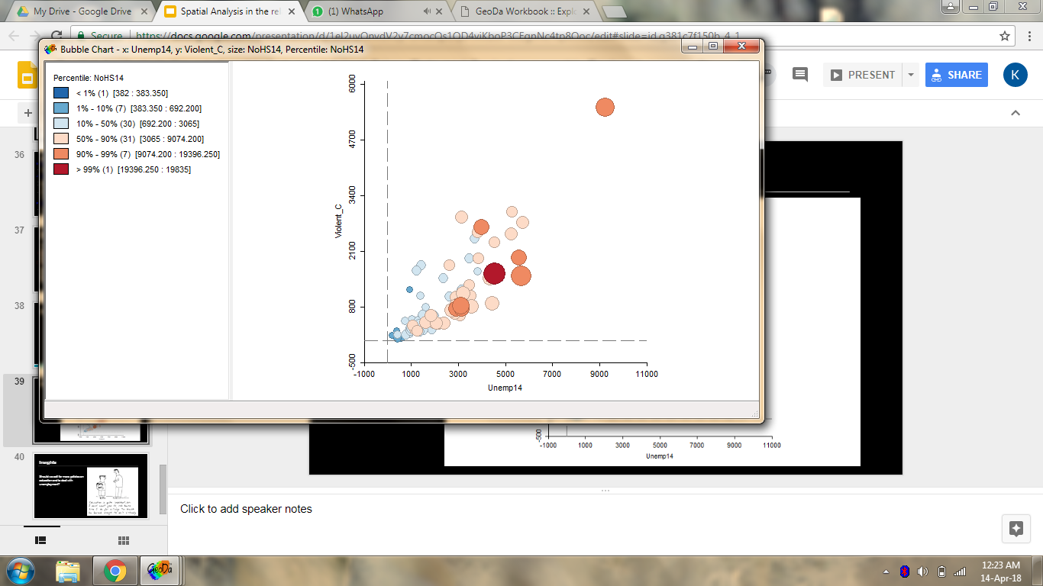
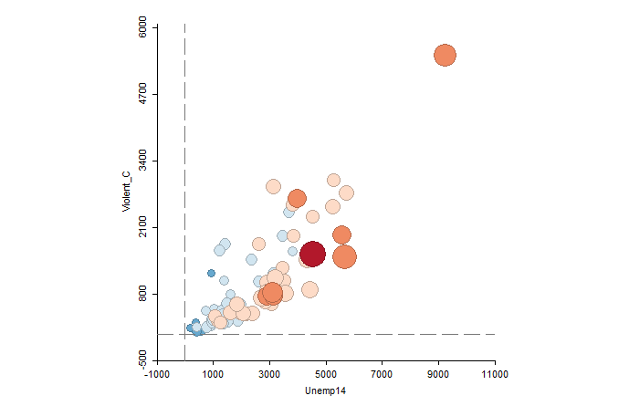
Bubble Map

Slide 42

Insights
Should we call for more policies on education and to deal with unemployment?
Notes:
https://www.quora.com/Is-there-any-relation-between-poverty-education-and-crime-rate
http://www.oxfordhandbooks.com/view/10.1093/oxfordhb/9780199914050.001.0001/oxfordhb-9780199914050-e-28

Slide 43


